Slide 1

Software Engineering Project Review Report 1
Bug Priority prediction using hybrid deep learning model
Presented By:
A. Charith, D. Parthava Naidu, D. Sridhar Aditya
(AV.EN.U4AIE22001, AV.EN.U4AIE22010, AV.EN.U4AIE22049)
Under the supervision of
Dr. Chandan Kumar
(Designation)
Department of Computer Science and Engineering
Amrita Vishwa Vidyapeetham, Amaravati Campus
Andhra Pradesh-522503

Slide 2
CONTENTS
INTRODUCTION
LITERATURE SURVEY
LITERATURE SURVEY OBSERVATION
OBJECTIVE
PROPOSED METHODOLOGY
RESULTS ANALYSIS
CONCLUSION
REFERENCES

Slide 3
INTRODUCTION
Bug detection and prioritization assist in identifying areas of a software system that are prone to containing defects.
Test case prioritization ensures that the most important test cases are executed first, addressing critical issues early.
As software systems evolve, bug detection and prioritization become essential to maintaining software quality.
Frequent code changes require strategic test execution to catch and resolve bugs efficiently.
Large test suites are time-consuming and expensive to execute, making prioritization crucial.

Slide 4
Key Benefits Of Bug Priority Prediction
Efficient Defect Management
Bug priority prediction helps identify which issues need immediate attention.
It ensures that critical and major bugs are addressed before minor and trivial ones.
2. Optimized Resource Allocation
Testing teams often have limited time, budget, and computational resources.
Automating bug prioritization allows testers to focus on high-impact issues first, reducing unnecessary delays.

Slide 5
3. Enhances Test Case Prioritization
In large projects, test case execution is costly and time-consuming.
Bug priority prediction aligns with test case prioritization, ensuring that high-risk areas are tested first.
4.Reduces Manual Effort and Human Error
Traditional bug triaging is done manually, leading to inconsistencies and subjectivity.
AI-driven bug prioritization standardizes the process, ensuring consistent and reliable results.

Slide 6
Literature Survey/Review

Slide 7
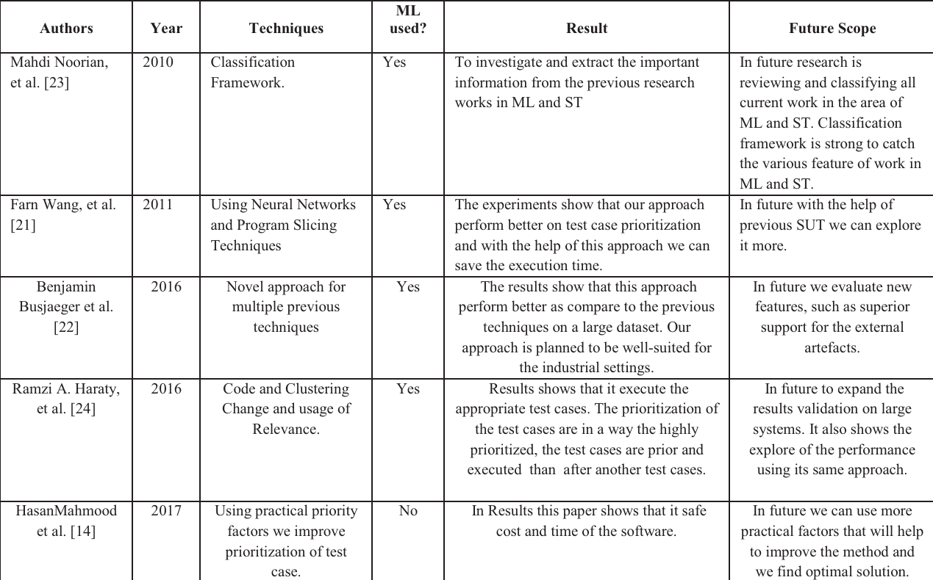
Literature Review

Slide 8
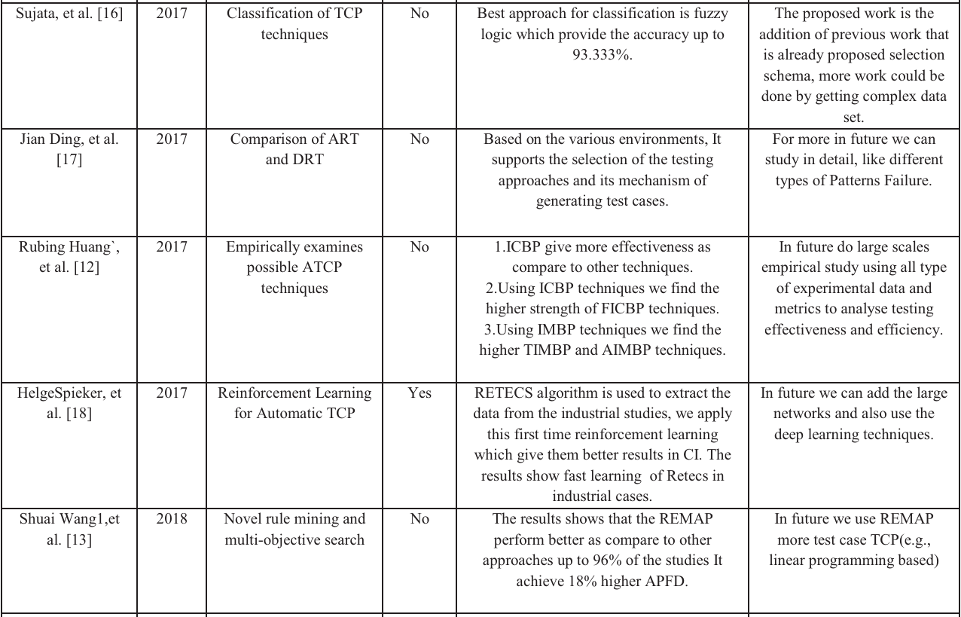

Slide 9
LITERATURE SURVEY OBSERVATION
Bug priority prediction has been explored using various machine learning techniques. Mahdi Noorian et al. (2010) used a classification framework to extract insights from prior research, aiding software issue categorization. Farn Wang et al. (2011) applied neural networks and program slicing to improve test case prioritization, which can be extended to bug ranking. These studies show ML’s potential in automating bug priority assignments
Several works highlight empirical validation using large-scale datasets. Benjamin Busjaeger et al. (2016) combined multiple prioritization techniques to improve defect ranking. Ramzi A. Haraty et al. (2016) used clustering to refine test case selection, ensuring critical defects are addressed first. Sujata et al. (2017) emphasized metadata-driven approaches, leveraging historical defect data for better prioritization.

Slide 10
Cont..
Future research suggests deep learning and hybrid models for better accuracy. Helge Spieker et al. (2017) proposed reinforcement learning for test prioritization, adaptable for bug ranking. Shuai Wang et al. (2018) showed rule mining and multi-objective search can optimize prioritization. Combining textual and tabular data with adaptive learning improves automated bug prioritization.

Slide 11
Objective
The objective is to enhance bug priority prediction using deep learning techniques for more accurate and efficient defect management.

Slide 12
Proposed Methodology
Data Preprocessing
Collect bug reports containing features like Title, Description, Status, Component, Assignee, and Timestamps.
Perform text preprocessing by tokenizing, removing stopwords, and applying stemming/lemmatization.
Encode categorical features (e.g., status, component) using one-hot encoding and normalize numerical values.
2. Feature Engineering
Extract meaningful textual and tabular features from the bug reports.
Use TF-IDF or word embeddings to represent textual features efficiently.
Select relevant structured attributes like Created Time, Resolved Time, and Assignee for better predictions.

Slide 13
Proposed Methodology
3. Methodology Architecture
Text Processing (LSTM Network)
Tokenize the ‘description’ column and convert text into word sequences.
Use word embeddings (5000 vocab, 128 dimensions) to represent text numerically.
Process text input using an LSTM layer (64 units) to capture sequential dependencies in bug descriptions.
Extract contextual meaning from textual descriptions to understand the severity of reported issues.
Tabular Data Processing (MLP Network)
Select structured features like Component, Status, Assignee, Created Time, Resolved Time.
Use a Dense (64 units, ReLU activation) to extract meaningful patterns from structured data.
Apply Batch Normalization to stabilize the learning process and improve generalization.

Slide 14
Proposed Methodology
Fusion Layer (Hybrid RNN-LSTM + MLP Approach)
Concatenation of Text & Tabular Data:
Combine LSTM-extracted features with MLP-processed tabular features.
Feature Refinement in the Fusion Layer:
Pass the concatenated data through a Dense (64 units, ReLU activation) for feature extraction.
Apply Dropout (0.3 probability) to enhance model generalization.

Slide 15
Proposed Methodology
4. Model Training and Evaluation
Train the Hybrid RNN-LSTM + MLP model using the Adam optimizer and categorical cross-entropy loss.
Split the dataset into 80% training and 20% testing to ensure a balanced evaluation.
Use accuracy, precision, recall, F1-score, and AUC-ROC to measure model performance.

Slide 16
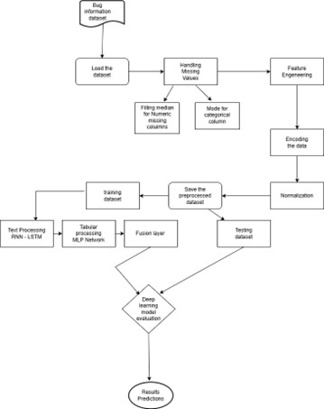
Flow chart

Slide 17
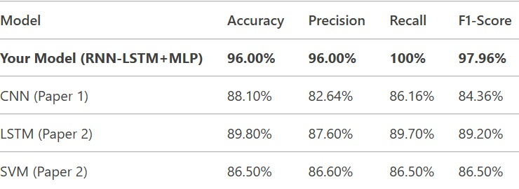
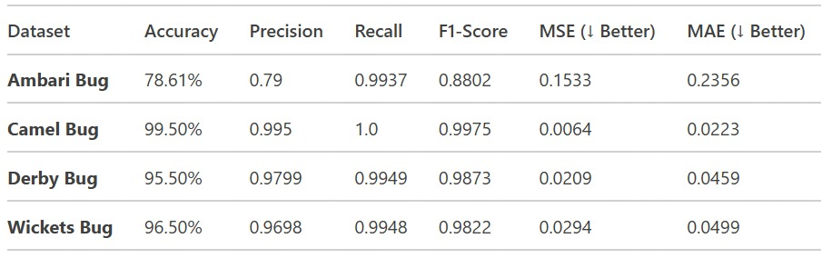
Results Analysis

Slide 18
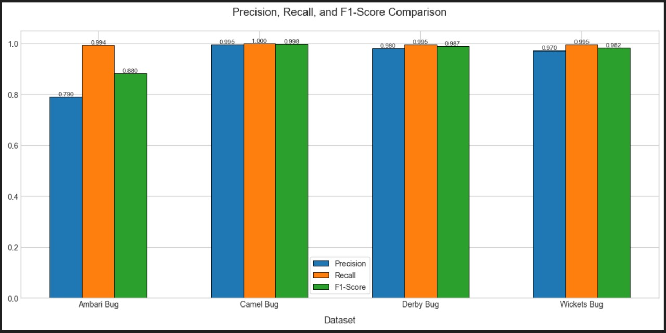
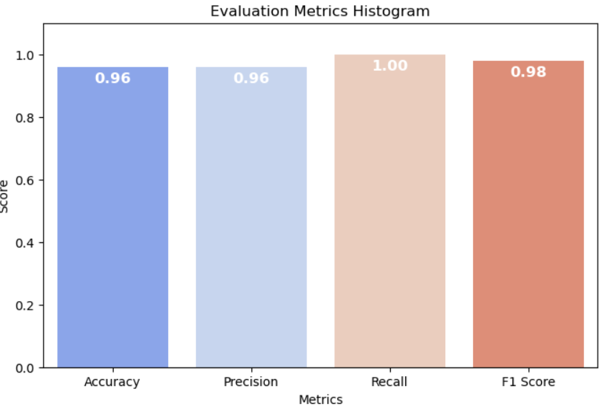
Visualization of the metrics

Slide 19
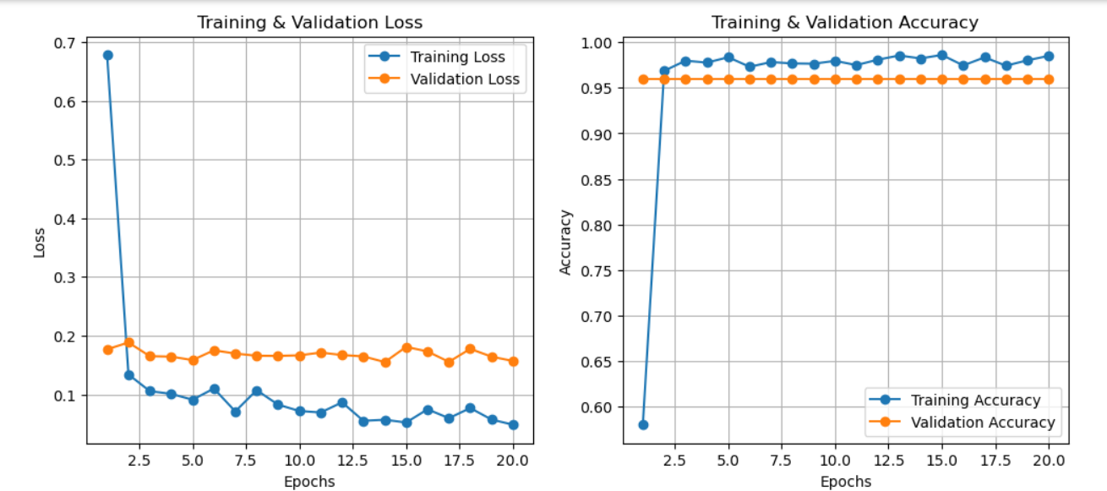
Training and Validation Loss and Accuracy

Slide 20
CONCLUSION
The proposed Bug Priority Prediction system utilizing a hybrid RNN-MLP deep learning model successfully automates and enhances the bug prioritization process. By integrating both textual and tabular features, the model effectively captures dependencies within bug reports, leading to improved classification accuracy. The feature extraction, preprocessing techniques, and hybrid fusion of sequential and structured data contribute to better generalization. The model's performance was evaluated using metrics such as accuracy, precision, recall, and F1-score, demonstrating its effectiveness in prioritizing software bugs for efficient debugging.

Slide 21
References
H. Rocha, G. De Oliveira, H. Marques-Neto, and M.T. Valente, “NextBug: a Bugzilla exten sion for recommending similar bugs,” Journal of Software Engineering Research and Development, Vol. 3, No. 1, 2015, p. 3.
Y. Tian, D. Lo, X. Xia, and C. Sun, “Auto mated prediction of bug report priority using multi-factor analysis,” Empirical Software Engi neering, Vol. 20, No. 5, 2015, pp. 1354–1383.
J. Anvik, L. Hiew, and G.C. Murphy, “Who should fix this bug?” in Proceedings of the 28th international conference on Software engineering, 2006, pp. 361–370.
S. Wang, W. Zhang, and Q. Wang, “FixerCache: Unsupervised caching active developers for di verse bug triage,” in Proceedings of the 8th ACM/IEEE International Symposium on Em pirical Software Engineering and Measurement, 2014, pp. 1–10.
S. Mani, A. Sankaran, and R. Aralikatte, “Deep Triage: Exploring the Effectiveness of Deep Learning for Bug Triaging,” arXiv:1801.01275 [cs], Jan. 2018. [Online]. http://arxiv.org/abs/ 1801.01275

